Slide 1


DESIGNING A BYTE-ENABLE MEMORY IN VERILOG AND SYSTEM-VERILOG
AY 2021-25
GITAM UNIVERSITY
Major Project
Project ID: PROJ2999
A University should be a place of light, of liberty, and of learning.
Department of Electrical Electronics and Communication Engineering
Project Team:
Maria Punya
Tammali Karthik
P.visweswara Rao
Project Mentor:
Dr. M. Arun Kumar
Associate Professor
www.gitamedu.com

Slide 2




Project Group – Details
Photo
Track
Roll No
Name
EECE AI/ML
BU21EECE0100309
MARIA PUNYA
EECE
BU21EEC0100164
TAMMALI KARTHIK
EECE AI/ML
BU21EECE0100086
P. VISWESWARA RAO

Slide 3
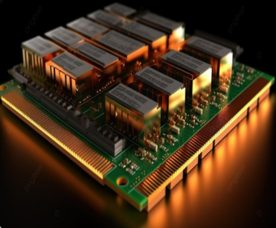
Abstract
Designing a byte-enable memory in verilog and system verilog involves creating a memory module that allows for selective enabling of individual bytes within a wider data word during read and write operations. This functionality is crucial in systems where precise control over memory access and modification is needed, such as in embedded systems, processors, and digital signal processing applications. Byte-enable memory modules are essential components in digital systems, enabling fine-grained control over memory operations. It prevents the implementation of a byteenable memory module using both verilog and system verilog. This optimizes memory usage and enhances performance in various applications, including embedded systems and data-intensive computing tasks. Mostly all embedded memory blocks that are implemented as rams support byte enables that mask the input data for specific bytes, nibbles, or bits of data. This process begins with defining the memory's architecture, including parameters such as word size, memory depth, and the number of bytes enabled. In verilog, the implementation involves creating a memory array and developing logic for handling byte-enable signals during read and write operations. It writes logic ensures that only the selected bytes are modified, while the read logic provides the correct data bytes based on the enable signals. In this proposed system, system verilog extends its capabilities by introducing advanced features such as type definitions, enumerations, and packed structures, which facilitate more efficient and readable code. The implementation in system verilog takes advantage of these features to streamline the design process, enhance code maintainability, and will improve simulation and byte-enable memory access efficiency, reduces power consumption, and enhances the flexibility of data handling in various computing systems.
Fig:- Random Access Memory(RAM) Background

Slide 4
Introduction
In today's complex digital systems, precise control over memory access and modification is essential for efficient and optimized operation. This is particularly true in applications such as embedded systems, processors, and digital signal processing, where data-intensive tasks are common. Byte-enable memory modules address this need by providing granular control over individual bytes within a wider data word during read and write operations.
Byte-enable memory modules are crucial components that enable selective byte-level manipulation in memory operations. These modules are often implemented in embedded memory blocks, such as RAMs, which support byte enables to mask input data for specific bytes, nibbles, or bits. This flexibility is invaluable in scenarios where only a portion of the data word needs to be modified or accessed.
The design process for a byte-enable memory module involves carefully considering several key factors. The memory's architecture must be defined, including parameters such as word size, memory depth, and the number of bytes enabled. Verilog, a hardware description language, is commonly used to create the memory array and develop the logic that handles byte-enable signals during read and write operations. This logic ensures that only selected bytes are modified and that the correct data is provided based on the enable signals.

Slide 5
Objective and Goals
Objective
The objective of this project are
To design and implement a byte-enable memory module using Verilog and SystemVerilog, optimizing memory usage by allowing selective access and modification of specific bytes within a larger word.
To enhance data integrity, performance, and scalability in digital systems by providing a versatile and efficient memory access interface, ensuring robust control mechanisms and minimal latency.
To contribute a comprehensive testing and validation framework using Verilog and SystemVerilog.
Goals
Main Goals
To optimize memory usage with selective byte-level access.
To improve performance with faster, precise byte modifications.
Reduce power consumption by accessing only necessary bytes.
Enhance data integrity and reliability with robust control mechanisms.

Slide 6
Project Plan
Gant Chart - Milestones and Activities
Resources : https://www.officetimeline.com/gantt-chart/how-to-make/excel & https://www.teamgantt.com/
SL.NO | Start Date | End Date | Description
1 | 23-july-2024 | 24-july-2024 | Gathering research papers and understanding the problem statement
2 | 31-July-2024 | 19-july-2024 | Abstract & Research for the project
3 | 22-july-2024 | 26-july-2024 | Workflow of the project
4 | 26-july-2024 | 30-july-2024 | Review-1
5 | 07-oct-2024 | 16-oct-2024 | Exploring the other concepts of the Project.
6 | 17-oct-2024 | 18-oct-2024 | Review-2

Slide 7
Literature Survey
Key Publications
Advancing cryptographic security: a novel hybrid AES-RSA model with byte-level tokenization, Apr 16, 2024
Optimizing Systems for Byte-Addressable NVM by Reducing Bit Flipping, February, 2019
Design and Implementation of Memory Controller for Byte Access from Data Memory for SoC's Devices, July, 2024
20nm High-density single-port and dual-port SRAMa with worldline-voltage-adjustments system for read/write assists, 06 March 2014.
A 45-nm Single-port and Dual-port SRAM family with Robust Read/Write Stabilizing Circuitry under DVFS Environment., 01 August 2008.
Key Resources – Whitepaper| Application Notes | Datasheet| Others
Xilinx Vivado
FPGA Kit
Existing Implementations – Products| Opensource| GitHub etc
Embedded Memory (RAM: 1-PORT, RAM: 2-PORT, ROM: 1-PORT, and ROM: 2-PORT) User Guide by Intel.

Slide 8
Literature Survey
SL.NO | TITLE | YEAR | TECHNOLOGY | DRAWBACKS | LINK
1. 2. | Advancing cryptographic security: a novel hybrid AES-RSA model with byte-level tokenization. Design and Implementation of Memory Controller for Byte Access from Data Memory for SoC's Devices | Apr 16, 2024 July, 2024 | byte-level Byte-Pair Encoding (BPE) tokenizer. RSA algorithm Advanced Encryption Standard (AES). System-on-Chip (SoC) Architecture. Advanced eXtensible Interface (AXI). Verilog and SystemVerilog UVM (Universal Verification Methodology). | Increased Computational Overhead Complexity in Key Management Potential Vulnerabilities in Tokenization Limited Scalability in Multi-Processor Environments. Limited Flexibility in Dynamic Environments Verification and Validation Challenges | [A] [B]

Slide 9
3. | Optimizing Systems for Byte-Addressable NVM by Reducing Bit Flipping | February, 2019 | Phase Change Memory (PCM). XOR Linked Lists. XOR Hash Tables. XOR Red-Black Tree. | PCM Write Endurance Power Consumption Memory Allocation Overhead. XOR Hash Tables, Complexity | [C]
4. 5. | 20nm High-density single-port and dual-port SRAMa with worldline-voltage-adjustments system for read/write assists. A 45-nm Single-port and Dual-port SRAM family with Robust Read/Write Stabilizing Circuitry under DVFS Environment. | 06 March 2014. 01 August 2008. | Wordline-Voltage-Adjustment System On-Chip Voltage Regulator Temperature Monitoring and Control Temperature and Process Variation-Based Adjustmen Improved Wordline Suppression Circuitry Negative Bitline Technique. 45nm CMOS Technology | Increased Complexity Write/Read Disturb Issues in DP-SRAM Timing Considerations Process Variation Sensitivity Complexity in Negative Bitline Implementation | [D] [E]

Slide 10
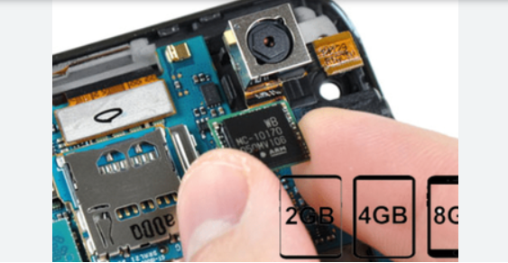
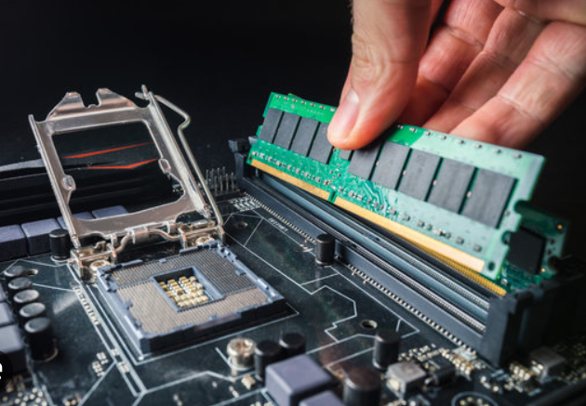
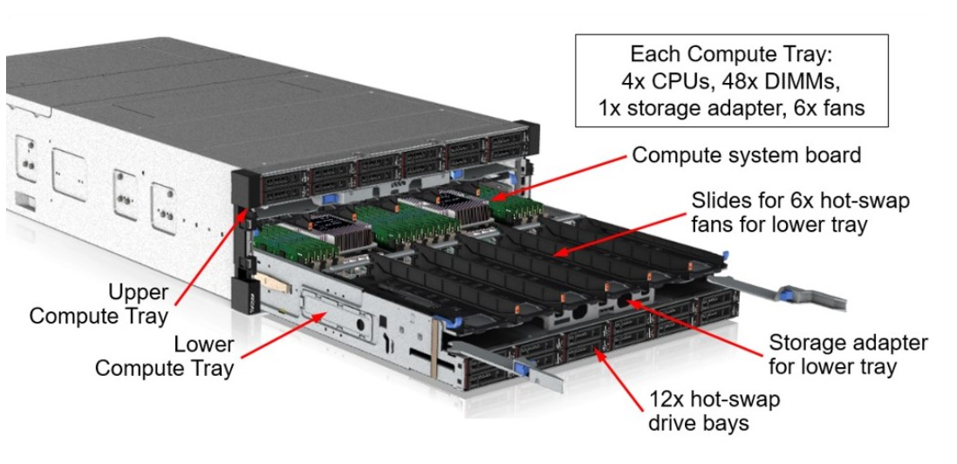
APPLICATIONS Of RAM
RAM IN MOBILE PHONES
RAM IN COMPUTERS
RAM IN SERVER

Slide 11
DESIGNING A BYTE-ENABLE MEMORY IN VERILOG AND SYSTEM-VERILOG
PROJECT FLOW:
Literature Survey & Abstract
Verilog
RAM
Single Port RAM
4x4 RAM
Generic RAM Characteristics
SRAM
DRAM
Generic 4X4 RAM Characteristics
Verilog
Implementation Differences
Results

Slide 12
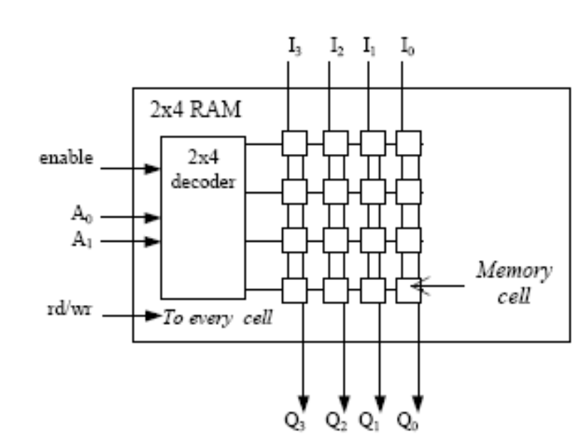
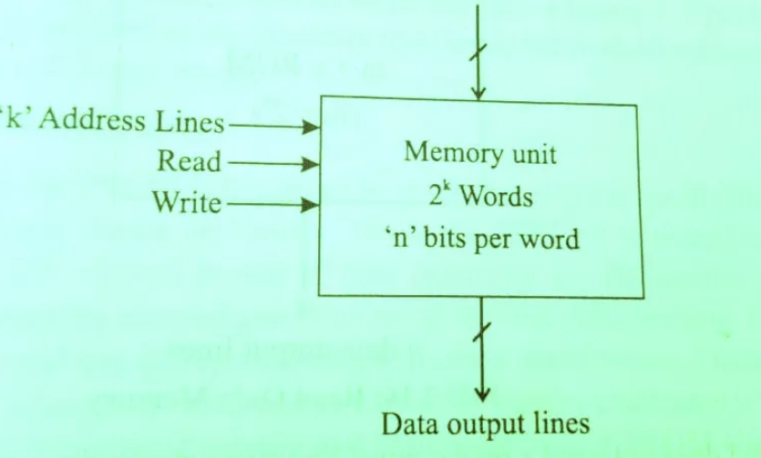
DESIGN SYSTEM:
RAM
RAM (Random Access Memory) is a type of computer memory that is used to store data that is actively being used or processed by the CPU. It is a volatile memory, meaning it loses its contents when the power is turned off, making it temporary storage. RAM plays a critical role in the performance of a computer or any digital system by providing quick access to data and instructions needed by the CPU.
Block diagram of RAM
Logical diagram of RAM

Slide 13
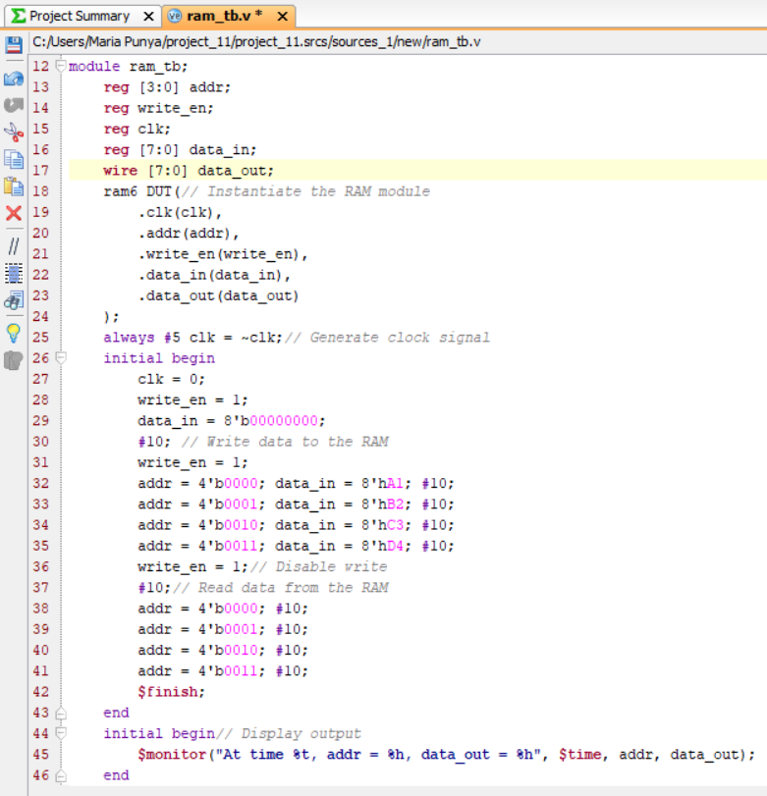
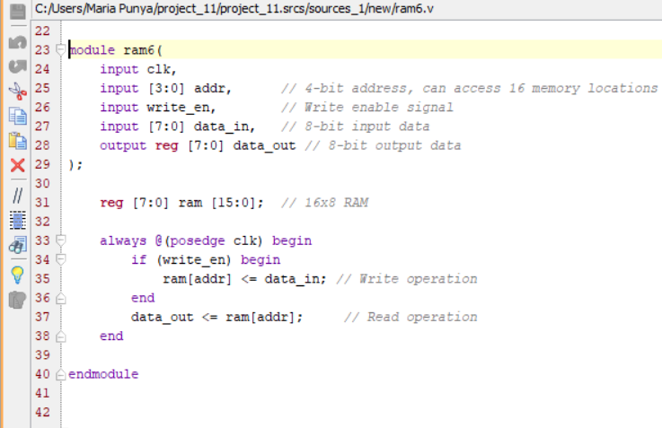
Verilog code for RAM:

Slide 14
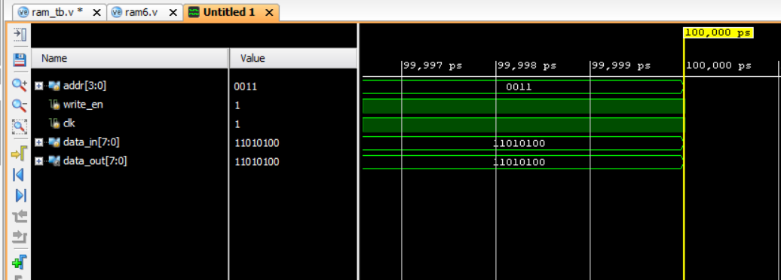
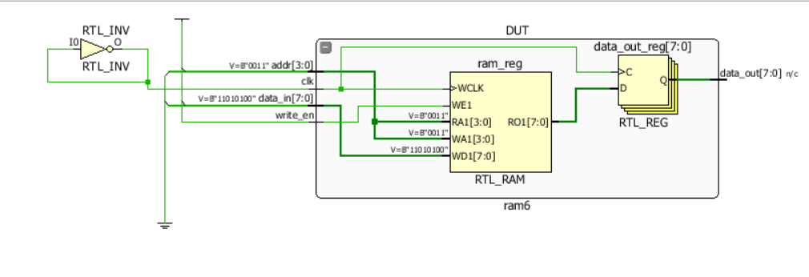
RESULTS:
Schematic Diagram:

Slide 15
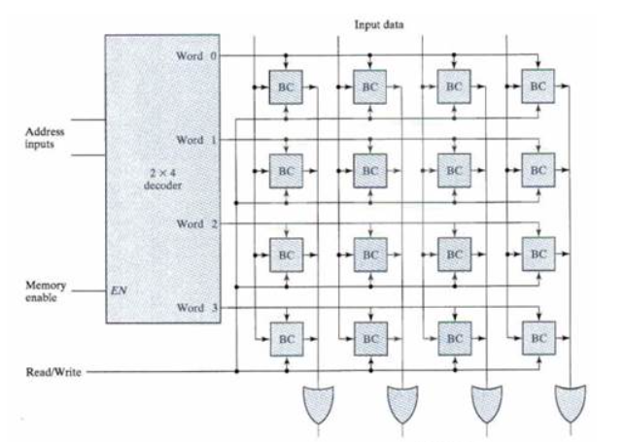
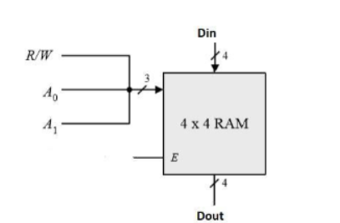
4X4 RAM A 4x4 RAM is a small memory unit that can store 16 bits of data, organized into 4 locations (or memory cells), each holding 4 bits. It uses 2 address lines to select one of the 4 locations, and 4 data lines to read from or write to that location. 4 Locations: Each location stores 4 bits. Addressing: 2 address lines (addr[1:0]) are used to select one of the 4 memory locations. Data Handling: 4-bit data can be written to or read from the selected location. Control Signal: A write enable (we) signal determines if data is written to memory (when high) or read from it (when low). Clock: Operations are synchronized using a clock signal (clk).
Block diagram of 4X4 RAM
Logical diagram of 4X4 RAM

Slide 16
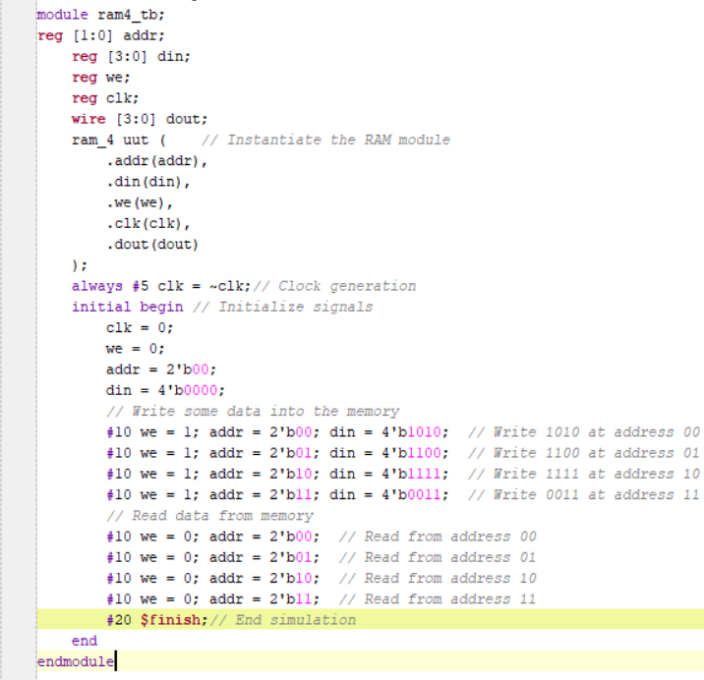
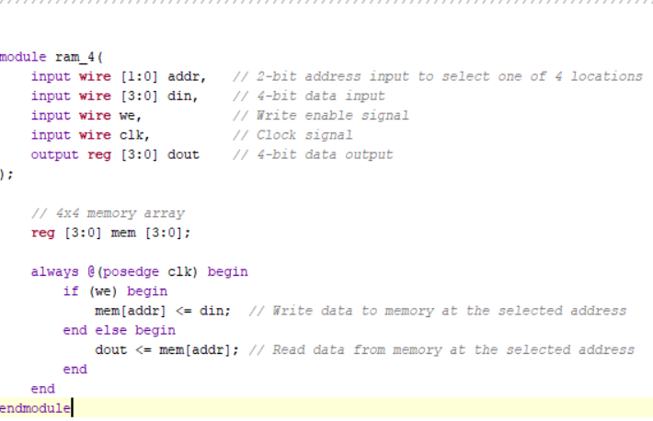
Verilog Code 4X4 RAM:

Slide 17
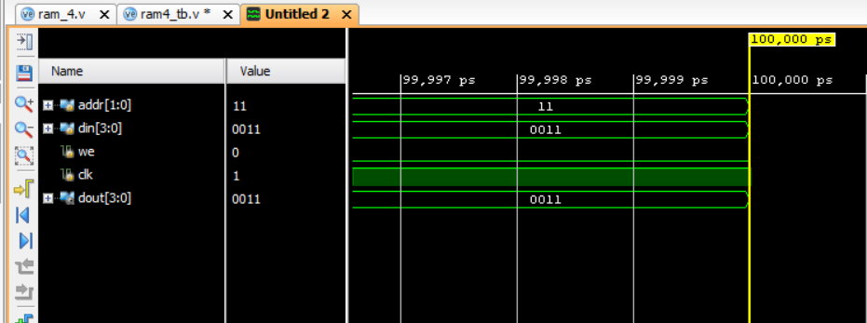
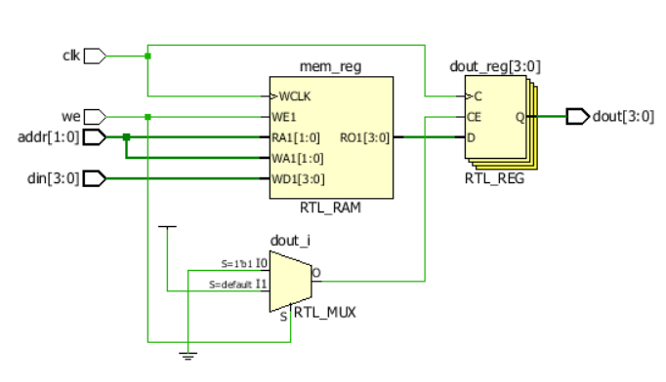
RESULTS:
Schematic Diagram:

Slide 18
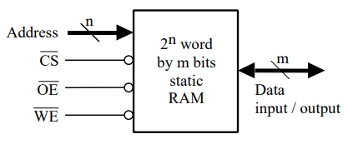
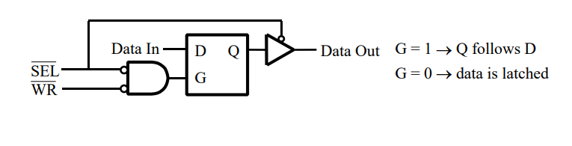
SRAM(Static Random Access Memory):
SRAM (Static Random Access Memory) is a type of memory that stores data using flip-flop circuits. Each memory cell in SRAM consists of a few transistors (typically 6) that can hold data as long as power is supplied. Unlike DRAM, SRAM doesn't require refreshing to retain data, which makes it faster but more expensive due to its higher transistor count.
Working Principle:
Read Operation: When the memory cell's address is provided and the read control signal is active, the data stored in the cell is transferred to the output.
Write Operation: When the write control signal is active, data is written into the selected memory cell at the given address.
Key features include fast access times and lower power consumption when idle, but SRAM is typically used for small amounts of high-speed memory, such as CPU cache, due to its size and cost.

Slide 19
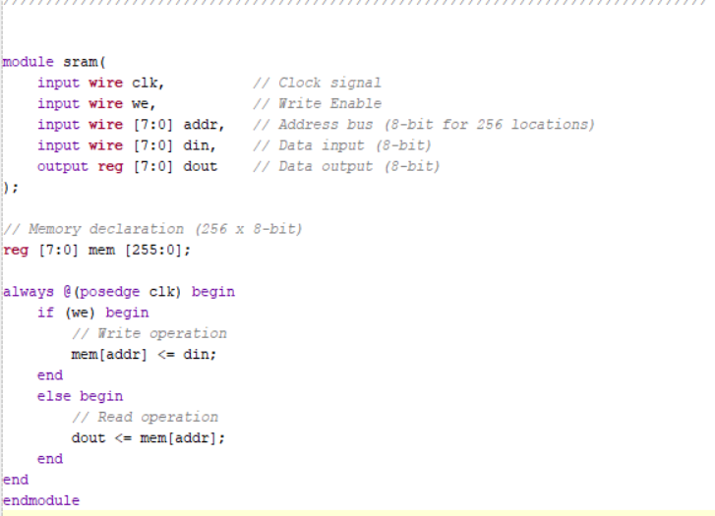
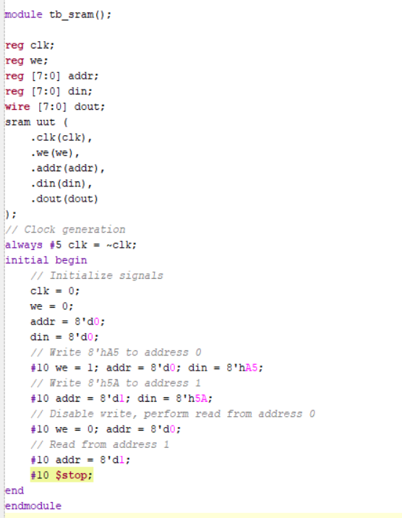

Slide 20
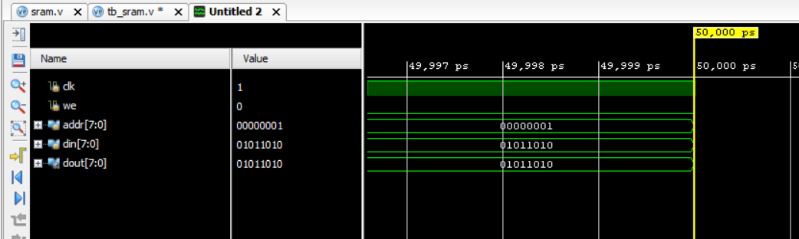
Results:

Slide 21
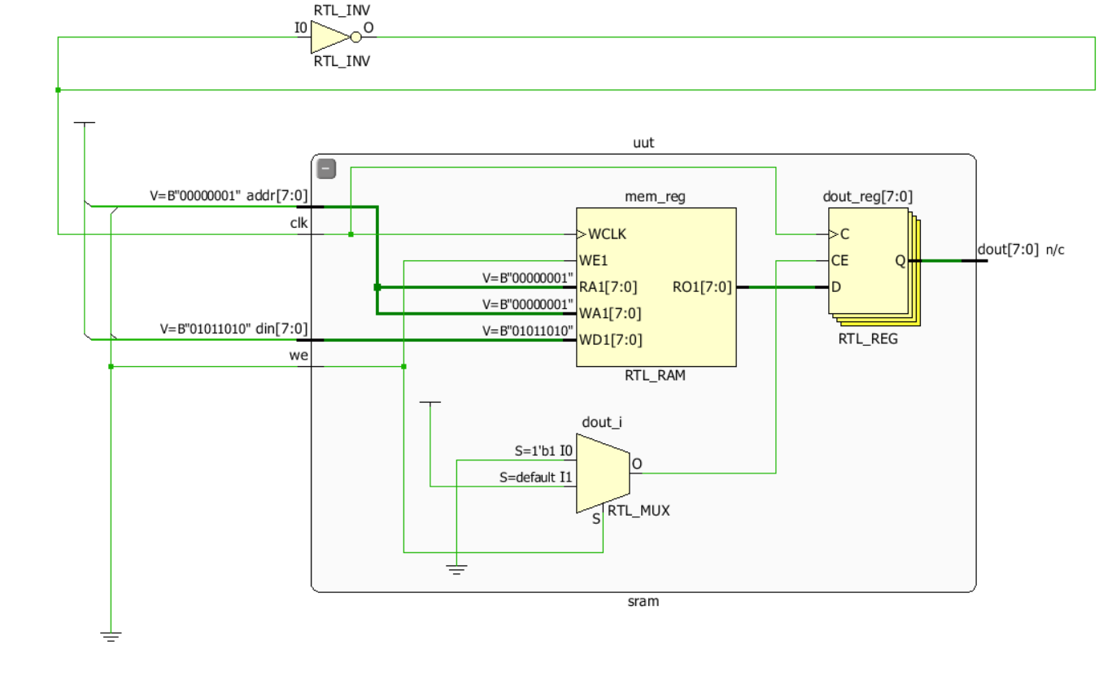
Schematic Diagram:

Slide 22
DRAM(Dynamic Random Access memory):
It is a type of volatile memory used in computers and other digital systems. Unlike SRAM, which stores data in flip-flops, DRAM stores each bit of data in a tiny capacitor within a memory cell. Due to the nature of capacitors, DRAM requires periodic refreshing to maintain its data, as the charge in the capacitors leaks over time.
Memory Cells: Each memory cell in DRAM consists of a capacitor and a transistor. The capacitor stores electrical charge, representing a bit of data (either a '1' or '0'). If the capacitor is charged, the bit is '1'; if discharged, it is '0'.
Read Operation:
The memory controller selects a row and column in the DRAM matrix.
The charge in the capacitor is read through a transistor.
Reading data from a DRAM cell discharges the capacitor, so it needs to be recharged (refreshed) immediately afterward.
Write Operation:
A specific row and column are selected, and data (as a charge or lack of charge) is written into the corresponding memory cell’s capacitor.
Refresh:
DRAM cells gradually lose their charge, so they need to be refreshed periodically (typically every few milliseconds) to retain data. The memory controller handles this refresh process.

Slide 23
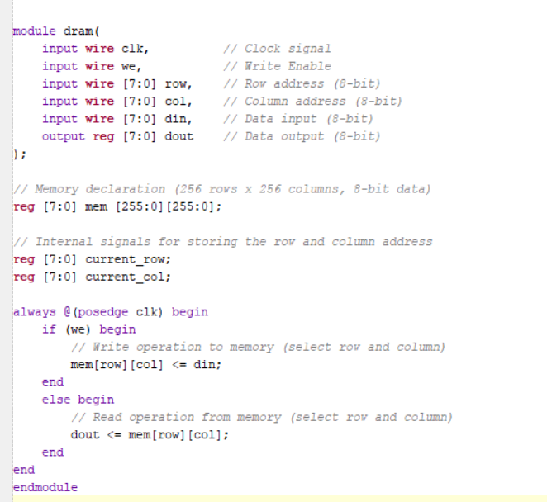
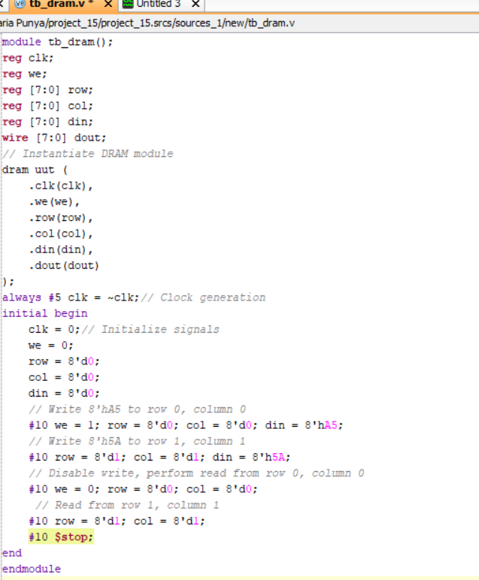
Verilog code for DRAM:

Slide 24
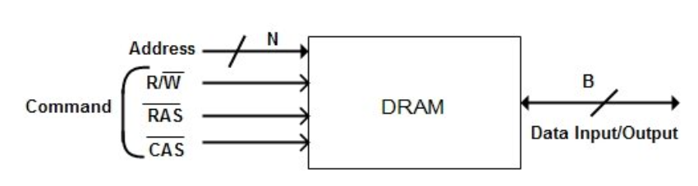
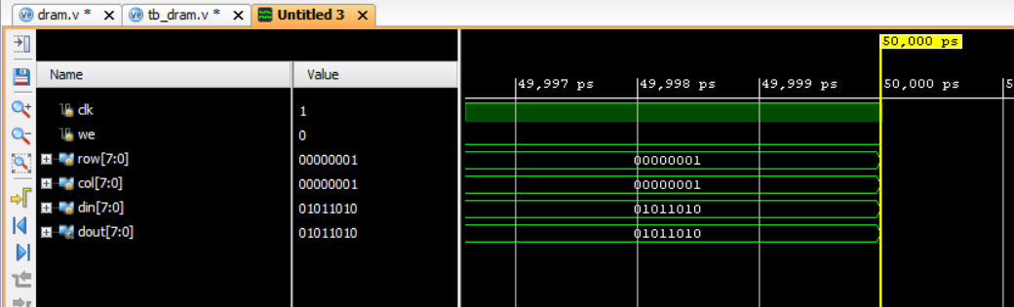
Results:

Slide 25
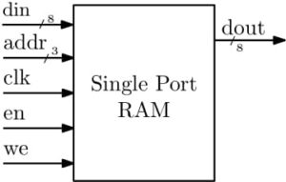
Single Port RAM:
Single-Port RAM (Random Access Memory) is a memory module that allows access to only one memory location (either read or write) at a time through a single address and data bus. Unlike dual-port RAM, where two different addresses can be accessed simultaneously, single-port RAM has a single address line, meaning it performs either a read or a write operation during a single clock cycle.
Components:
Clock (clk): Controls when data is read or written.
Write Enable (we): Determines if data is written to memory during a clock cycle.
Address Bus (addr): Specifies the memory location for reading or writing.
Data Input (data_in): Carries the data to be written into memory.
Data Output (data_out): Holds the data being read from memory.
Block Diagram Single-Port RAM

Slide 26
Working of Single-Port RAM:
Clock Cycle Synchronization:
The operations are synchronized with the clock. On every positive edge of the clock, either a read or write operation takes place.
Write Operation:
If the we (write enable) signal is high during a clock cycle, the data present on data_in is stored in the memory at the address specified by the addr bus.
Read Operation:
If the we signal is low, the data stored at the address on the addr bus is placed on the data_out bus, allowing it to be read.
Applications:
Cache Memory: Used in simple cache memory implementations where only one cache line can be accessed at a time.
Embedded Systems: Common in microcontroller and FPGA-based designs to store data.
Buffer Storage: Used to store temporary data in small processing systems.

Slide 27
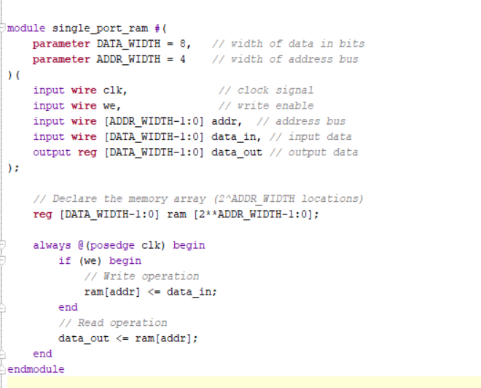
Verilog Code:

Slide 28
Start
Define Parameters
DATA_WIDTH
ADDR_WIDTH
Declare Inputs and Outputs
clk
we
addr
data_in
data_out
Declare Memory Array
reg [DATA_WIDTH-1:0]
ram [2**ADDR_WIDTH-1:0]
Check if Write Enable
ram[addr] <= data_in;
ram [2**ADDR_WIDTH-1:0];
we(active)
else
ram[addr] <= data_in;
data_out <= ram[addr]
End

Slide 29
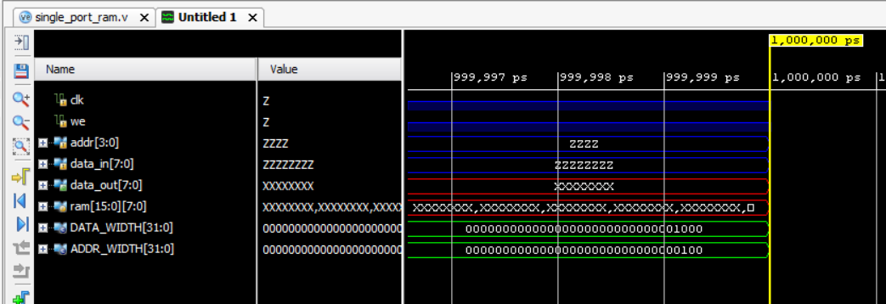
Results:

Slide 30
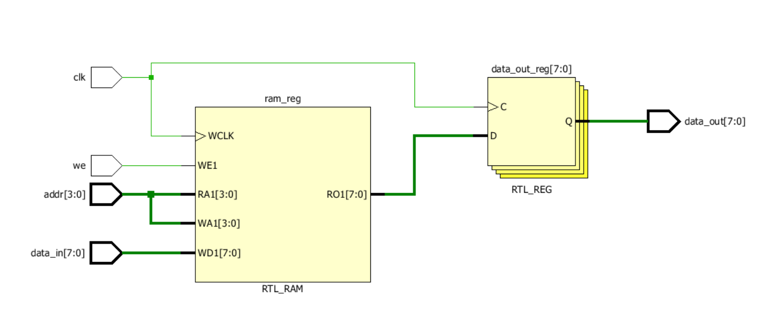
Schematic Diagram:

Slide 31
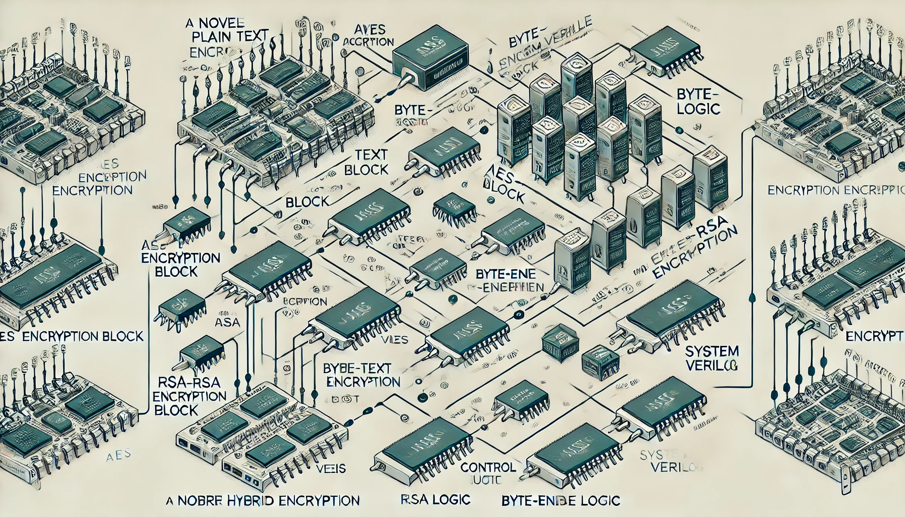
Application Implementation:
Advancing cryptographic security: a novel hybrid AES-RSA model with byte-level tokenization
Designing a hybrid AES-RSA model with byte-level tokenization involves integrating both Advanced Encryption Standard (AES) and Rivest–Shamir–Adleman (RSA) cryptographic techniques. The following steps outline the workflow for this security model, including descriptions, flowcharts, and block diagrams.

Slide 32
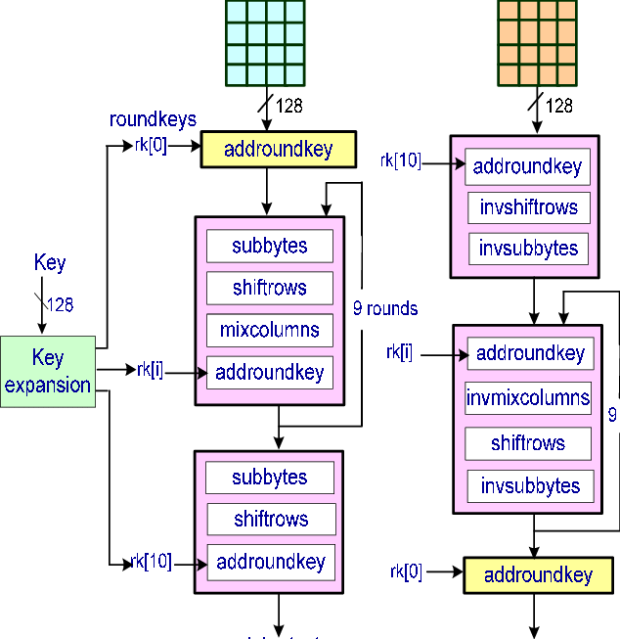
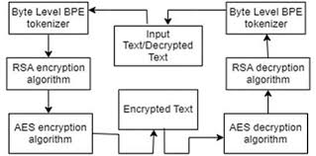
PROJECT FLOW
Hybrid AES-RSA
Data Transmission/Storage
Data Input
Data Decryption
AES Encryption
RSA Decryption (decrypts AES key)
Fig:- File Encryption/Decryption process
Byte-Level Tokenization
Byte-Level De-Tokenization
AES Decryption
RSA Encryption
(for AES key encryption)
Data Output
Fig:- Byte-Level Tokenization flow

Slide 33
Analysis - SWOT
Strengths
Weaknesses
W1. Complexity: Designing byte-enable memory is challenging.
W2. Debugging Difficulty: Hardware debugging is tough.
S1. Flexibility: SystemVerilog offers advanced features.
S2. Industry Relevance: Verilog and SystemVerilog are widely used in the hardware design industry, making skills in these languages highly valuable.
Threats
T1. Evolving Standards: Continuous need to adapt to new methodologies.
T2. Competition: Pressure to deliver efficient designs quickly.
Opportunities
01. Optimization: There is a significant opportunity to optimize memory usage, power consumption, and performance by designing efficient byte-enable memory.
02. Customization: Tailor designs for specific applications.
O3. Advancements in Verification: Use advanced verification features.
04. Career Advancement:: Expertise in Verilog and SystemVerilog can open doors to advanced roles in hardware design, verification, and EDA tool development.

Slide 34
Analysis – 4W1H
Why: To optimize memory efficiency and system performance by enabling selective byte-level access.
What: Design and implementation of a byte-enable memory module using Verilog/SystemVerilog.
Where: Used in embedded systems, digital processors, and SoC architectures requiring efficient memory access.
When: Useful in scenarios requiring frequent modification of specific bytes within larger memory blocks.
How: Implemented using Verilog/SystemVerilog with simulations to ensure performance, control, and low latency.
Refined Objective: Design an efficient, low-latency byte-enable memory module for improved system performance and reduced power consumption.

Slide 35
Use Cases & Testing
Use Cases
Embedded Systems: Byte-enable memory optimizes memory access in embedded systems by allowing selective read/write operations, reducing memory usage and power consumption in resource-constrained environments.
Digital Signal Processors (DSP): In DSP units, byte-enable memory enables efficient manipulation of data by allowing targeted access to specific bytes, improving processing speed and reducing data latency.
Networking Buffers: Byte-enable memory can be used in network packet buffers, allowing selective modification of specific bytes in data streams, which is crucial for handling variable-length packets efficiently.
Graphics Processing Units (GPUs): Byte-enable memory helps GPUs manage texture data or pixel information by selectively accessing memory regions, reducing the need for full data block transfers and enhancing rendering speed.
Low-Power IoT Devices: In Internet of Things (IoT) applications, where power efficiency is critical, byte-enable memory reduces energy consumption by enabling precise data access, minimizing unnecessary memory operations..
Test Cases
Basic Read/Write Test: Verify that data can be correctly written to and read from specific memory locations. For instance, write a word to a memory address, then read from the same address to confirm the data matches.
Selective Byte Access Test: Test the ability to modify only a specific byte within a word. Write a word to memory, change only one byte of that word, and verify that the other bytes remain unchanged during the readback.
Boundary Condition Test: Check memory behavior at the boundary of memory address space. Perform read/write operations at the first and last memory locations to ensure no overflow or underflow occurs.
Memory Integrity During Data Modification: Test the memory’s ability to maintain integrity during concurrent write/read operations. Simulate simultaneous access to adjacent bytes and ensure that data is not corrupted during modification.
Power Consumption Test (Optional): Measure power consumption during selective byte operations compared to full-word operations. Verify that power usage is optimized when only specific bytes are accessed, ensuring the design's efficiency.

Slide 36
Implementation and Results
Simulation Results of RAM
Simulation Results of 4X4 RAM

Slide 37
Simulation Results of SRAM
Simulation Results of DRAM

Slide 38
Simulation Results of Single_Port_RAM

Slide 39
Contribution
Team Progress and Movement
Implementation and verification of RAM,4X4 RAM, SRAM,DRAM in Verilog
Implementation and verification of Single port RAM in Verilog.
Individual Contribution
Key contributions: P.Visweswara Rao
Working on Implementation and Design of RAM, 4X4 RAM.
Literature Survey
Key contributions: Tammali Karthik
Working on Implementation and Design of SRAM,DRAM
PPT Design
Key contributions: Maria punya
Working on Implementation and Design of Single port RAM.
PPT Design

Slide 40
Conclusion & Future Work
Summary and Conclusion
Summary Single-port RAM supports byte-enable functionality by allowing selective modification of specific bytes within a word during write operations. In Verilog, byte-enable memory is implemented by decoding the byte-enable signals to determine which parts of the data are written to memory while the rest remain unchanged. This approach provides more flexibility and finer control over memory updates without affecting the entire word.
Conclusion Implementing byte-enable in single-port RAM using Verilog is a practical method for achieving efficient memory management in systems where partial updates are required. It offers a good balance between memory size and access speed, making it suitable for various digital designs, especially in resource-constrained environments.
Future Work
Enhance Timing Performance:
Optimize the single-port RAM design to support higher clock speeds by reducing timing delays and improving signal integrity.
Scale Memory Size:
Investigate scaling strategies for larger memory sizes while maintaining byte-enable functionality and performance, especially in FPGA and ASIC implementations.
Implementation Strategy:
Design the byte-enable memory in Verilog and SystemVerilog using a single-port RAM as the core memory.

Slide 41

THANK YOU

